Slide 1
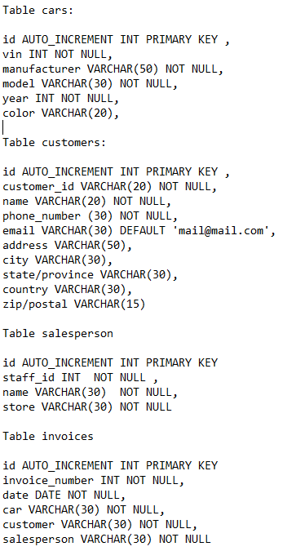
One or many
One or many
One or many
One
One
One or many

